Slide 1
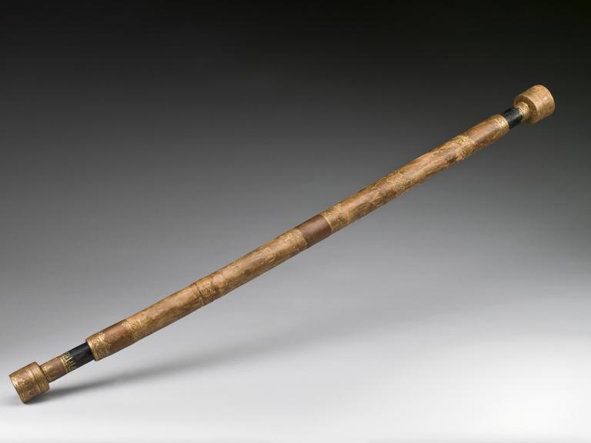
Telescope by Galileo Galilei
by Pavel Ghazaryan

Slide 2
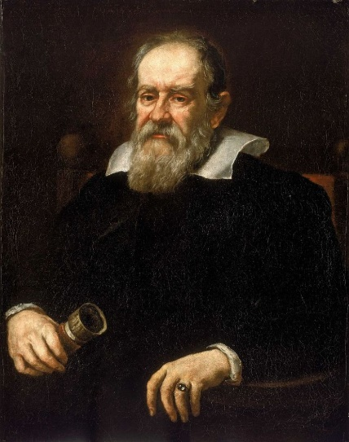
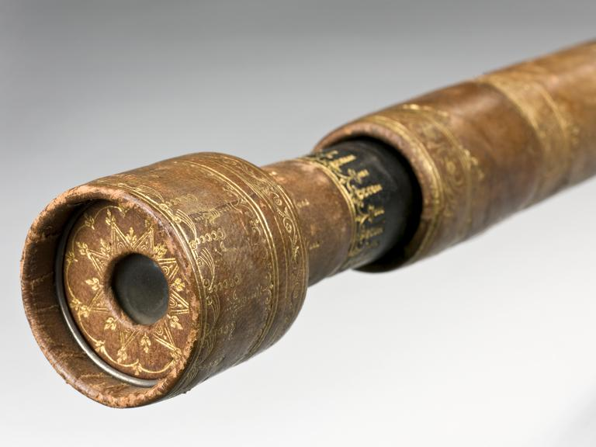
History
In 1608 two spectacle makers had applied to the Dutch government for a patent for a device for seeing at a distance. The news has spread through Europe and in 1609 Galileo Galilei has created his own telescope.

Slide 3
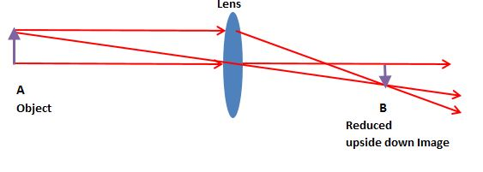
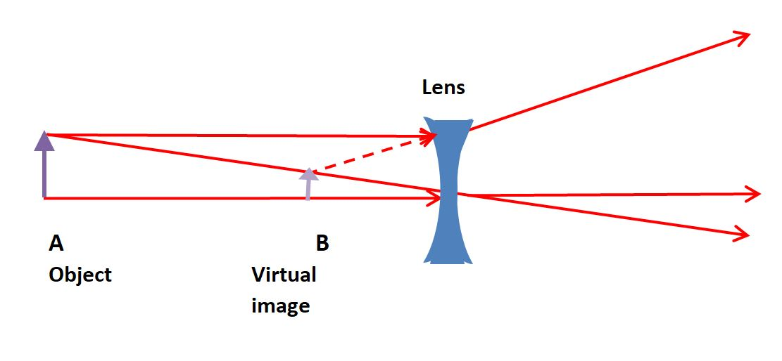
How it worked?
Converging lens
Diverging lens
Images from https://explainingscience.org/2018/03/13/galileo-and-the-telescope/

Slide 4
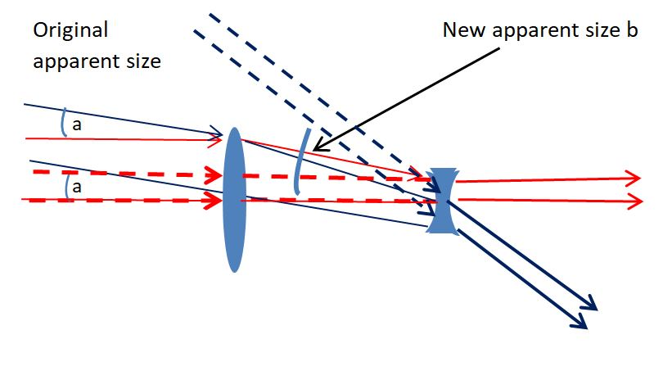
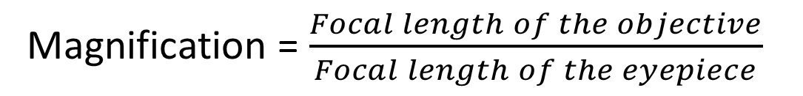
Telescope (Converging and Diverging lenses combined)
Images from https://explainingscience.org/2018/03/13/galileo-and-the-telescope/
Magnification = $\frac{Focal length of the objective}{Focal length of the eyepiece}$

Slide 5
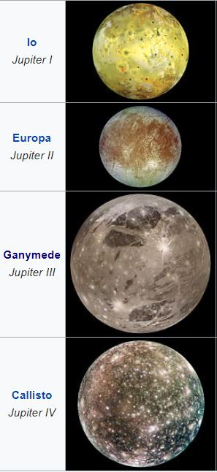
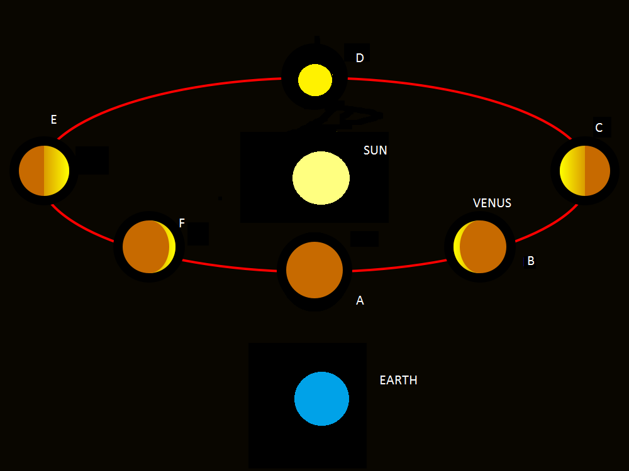
Significance
Images from https://explainingscience.org/2018/03/13/galileo-and-the-telescope/

